Slide 1
Take a seat anywhere, but please do not touch the materials on your table yet.

Slide 2
Welcome! Mr. Sellek’s Pre-AP English
Fall 2017
World Literature

Slide 3
Course Description, or, what the class is about
Looking at how literature works through a variety of lenses to understand how to become better readers, and therefore, better writers.
Class will be very focused on individualized thought processes as well as general discussion, both in your “pods” and within the entire classroom.
Will be specifically looking at the following books:
Night
All Quiet on the Western Front
The Metamorphosis
Julius Caesar
We will also be using our summer reading in Freakanomics THROUGHOUT the entire year.

Slide 4
A Bit About Me
Graduated with a Bachelor’s in English and Christian Studies from The College at Southeastern
Graduated with a Master’s degree in English Education from North Carolina State University
Originally from Miami and a family of seven
Likes movies, coffee, reading, and writing

Slide 5
Contact Information
My Weebly page is mrsellek.weebly.com
Email is the best way: Using your WCPSS issued email address, you can sent it to msellek@wcpss.net
Will be sending out reminders through my Twitter page @MrSellekTweets
Can also sign up for Remind101 by texting 81010
A Day? Text @mrselleka to 81010
B Day? Text @mrsellekb to 81010

Slide 6
Classroom Rules A

Slide 7
Classroom Rules B

Slide 8
Bathroom Policy
If you need to go to the hallway, silently take a pass and go.
This can be used for bathroom, water, going to your locker (if that’s even a thing anymore), hand-washing, flossing, impassioned punch-dancing, etc., etc.
Not to be used to roam the halls or for having a little break
If they get out of hand, I will not allow you to go during class anymore

Slide 9
Late Work Policy
Late work will be accepted with eleven points being docked every day it is late for the first three days
After that, the base grade that you will get is a sixty-nine percent
Points can be taken off from there depending on the quality of the work

Slide 10
Absence Policy
If you’re absent, check my Weebly (mrsellek.weebly.com) in order to get what you need.
If you need further help, ask me or a peer. DO NOT do this during class time. Come before or after class, or during Husky Help.
YOU ARE RESPONSIBLE FOR THE JOURNAL ENTRY FOR ANY DAY THAT YOU WERE OUT.

Slide 11
Cell Phone Policy and A/B Schedule

Slide 12
What I’m Looking For
I am not looking for you to impress me with your vast knowledge of literature and the English language
There are no geniuses in this class
I am looking for you to work hard, to mold your mind to grow, to learn the material, and then to contribute

Slide 13
Use Them Skills
In front of you are a variety of materials from around the classroom.
Using just those materials (and yourselves, obviously), try to make something that puts your paperclip as high as you can.
Think to yourself for two minutes silently first. You may write something, draw, whatever helps. Then you’ll work as a group to put your structure together.

Slide 14
Multiple Intelligences
If you are an “A”, you are considered a linguistic learner. You will be the group’s recorder.
If you are a “B”, you are considered an interpersonal learner. You will be the group’s leader.
If you are a “C”, you are considered an intrapersonal learner. You will be the group’s thinker.
If you are a “D”, you are considered a bodily kinesthetic learner. You will be the group’s mover.

Slide 16
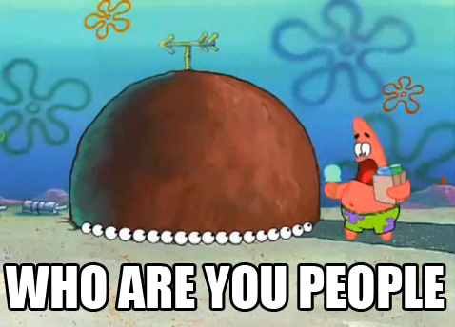
Getting to Know You

