Slide 1
Shakespeare and Elizabethan Theatre

Slide 2
William Shakespeare
A playwright, poet, actor, and director who is responsible for forty plays, one hundred fifty-four poems (or “sonnets”), and one thousand seven hundred words in our modern English language
NOT Old English! This is early modern English, and is more of the beginning of the way we speak.

Slide 3
Real Old English vs. Shakespeare
Hwæt we garde- na ingear dagum, þeod cyninga þrym ge frunon huða æþelingas elle[n] fremedon.
As opposed to…
How do I love thee? Let me count the ways.
I love thee to the depth and breadth and height
My soul can reach, when feeling out of sight

Slide 4
What Did He Do?
While living, Shakespeare founded the “Lord Chamberlain’s Men”, a travelling theatre company that became so famous, it eventually performed for the Queen and King of England
Wrote and directed the plays that they would put on, usually writing a part for each actor he had
Plays came in two genres…
Comedy: A play with a happy ending
Tragedy: A play with a tragic ending

Slide 5
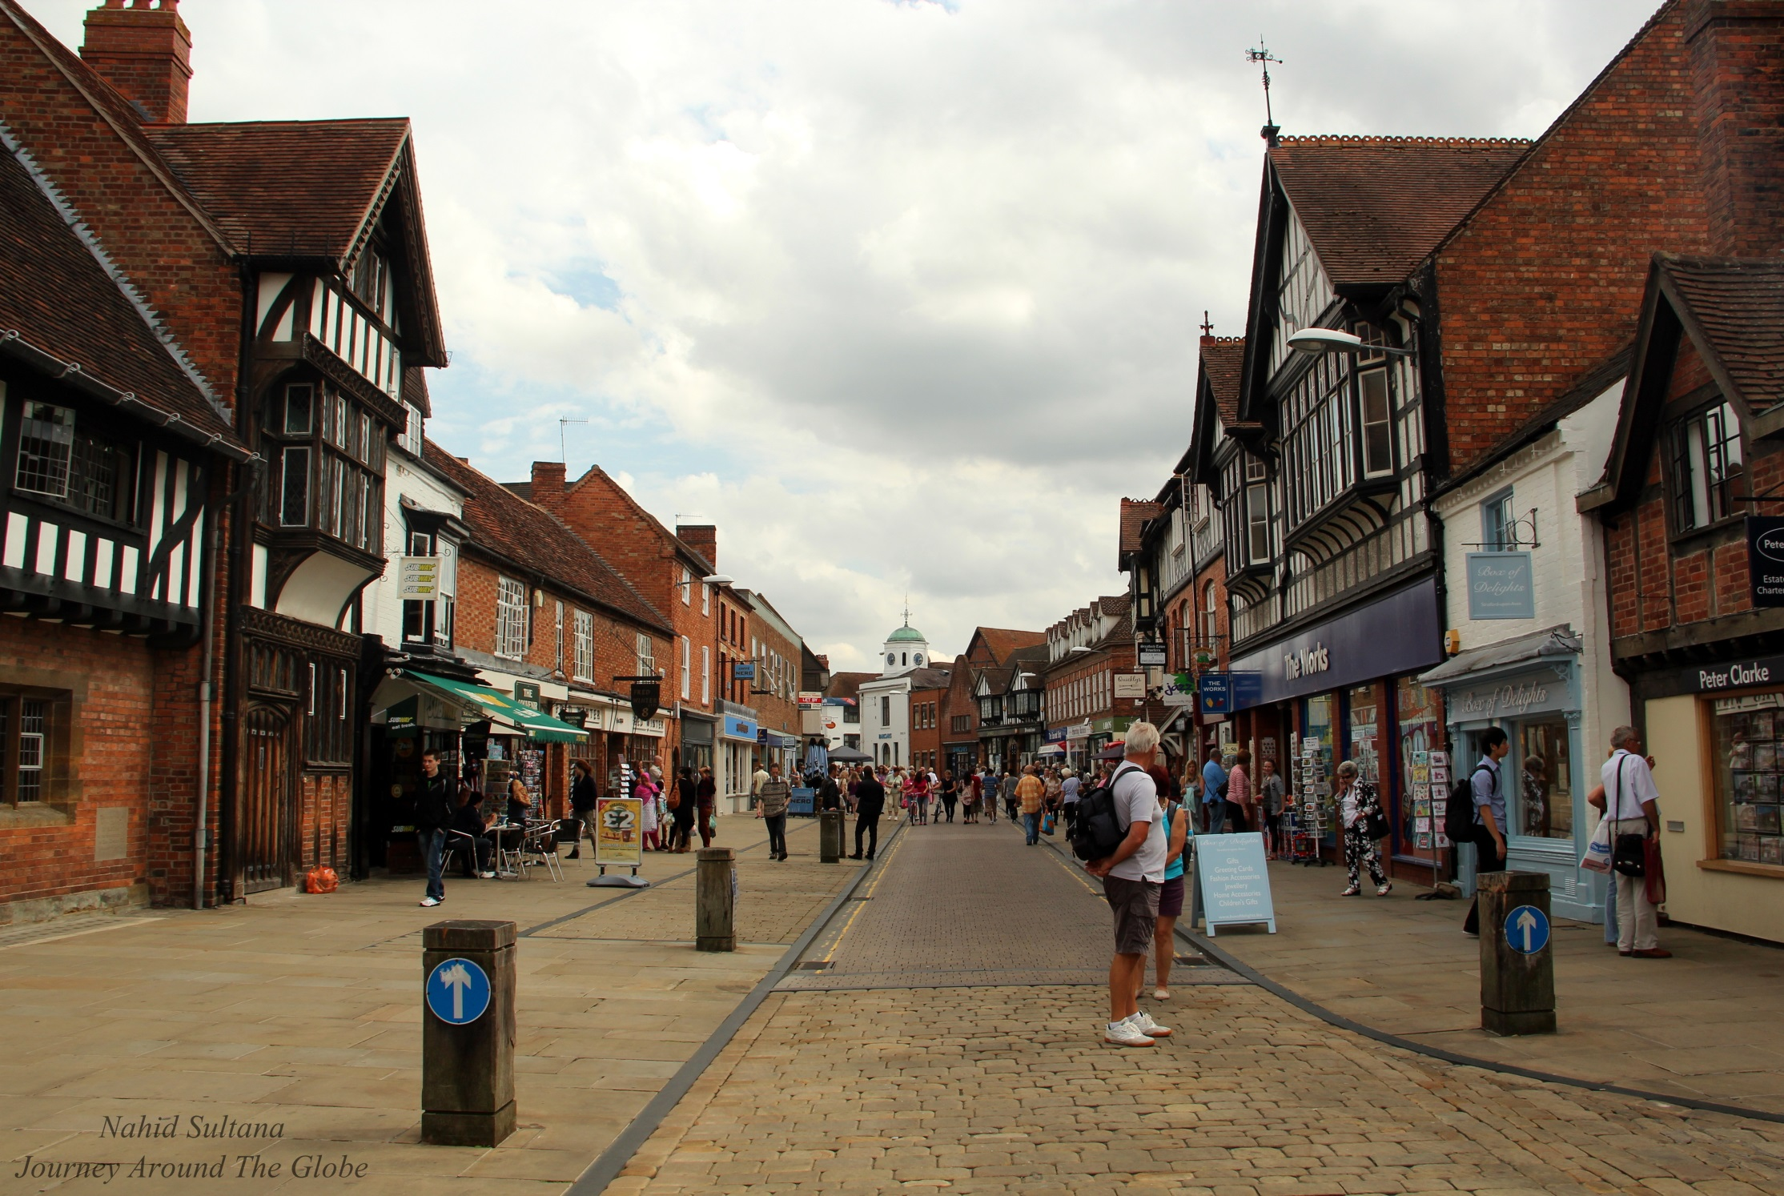

Slide 6
Words Shakespeare Created
Beached
Elbow
Rant
Gossip
Luggage
Torture
Drugged
Bedroom
Bet
Worthless
Critic
Undress
Mimic
Blushing
Obscene
Assassination
Advertising
Addicting
Bump
Fashionable
Eyeball
Hint
Lonely
Majestic
Blanket
Amazement
Buzzer
Deafening
Lower
Fixture
Gloomy
Puking
Scuffle
Swagger
Flawed
Excitement
Dawn

Slide 7
Not only that…
Shakespeare is often remembered for the dialogue and expressions that he created. We still use many of them today
Tis better to have loved and lost than never to have loved at all
All’s fair in love and war
All that glitters is not gold
In a pickle
Heart of Gold
And even one of the first “yo mama” jokes
“Thou hast undone our mother”
“Villain, I hath done thy mother!”

Slide 8
Performances
Shakespeare was NOT a high-brow writer; meaning, he did not write for those who were educated or wealthy
The majority of his audience were illiterate and lower class
Not a very forgiving audience…where we get the idea of throwing vegetables at performers
While they did travel, they eventually settled in The Globe Theater

Slide 9
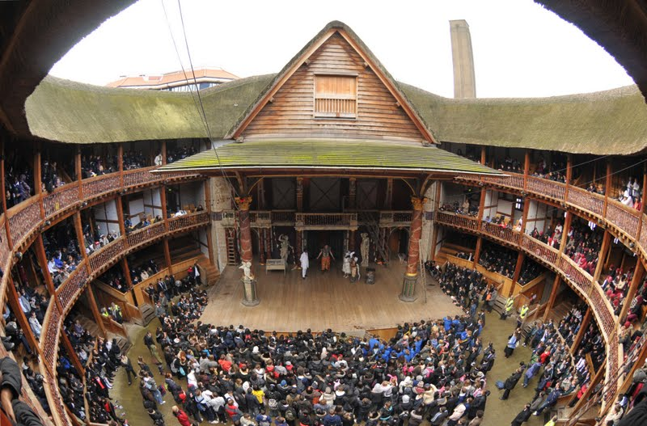

Slide 10
Why We Read What We Read
Had to consistently remind audience of what was happening
Props and sets were minimal—no electricity and limited machinery
Written in iambic pentameter
Needed to write something for each character. Why there is often…
A comic relief: For the comedian of the group
A chorus: A group of ensemble members with lines read as a group
Also a Greek idea

Slide 11
Helpful “Translations”
Thee/Thou: You
Thine: Your
Art: Are
Hath: Has
Wherefore: Why
Dost/Doth: Does or Do
Marry: Indeed
Hence: Away
Ere: Before

Slide 12
Cast of Characters
Macbeth: The thane (kind of like a duke) of Glamis who wants more power.
Lady Macbeth: Macbeth’s wife, even more ambition than he is.
The Three Witches: Like the fates, give prophecies and represent evil or black magic.
Banquo: A noble general whose morals mean more than power
King Duncan: The good King of Scotland
Macduff: A noble who is hostile towards Macbeth

