Slide 1
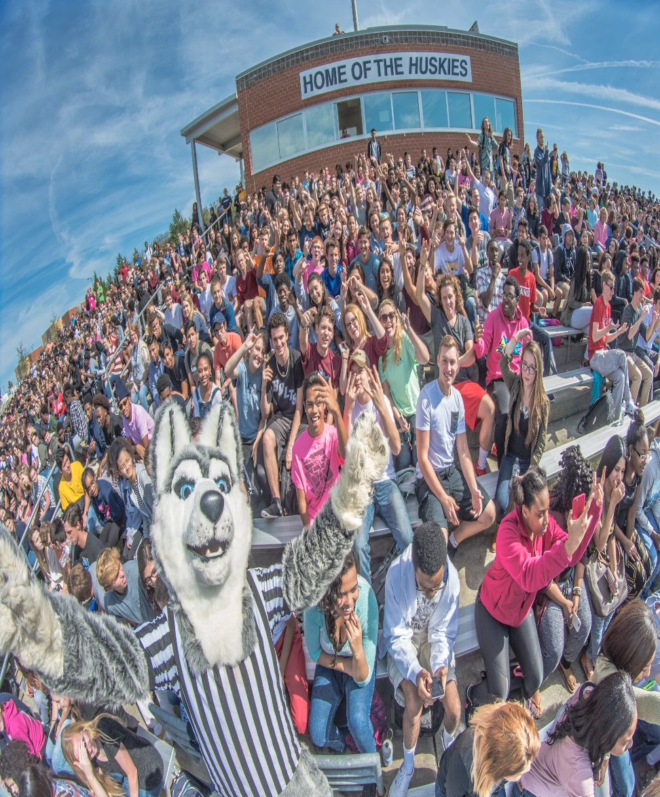
Welcome to Talking Day!!
Welcome to a Talking Day.
Click to the next slide ASAP!
Let’s get started.
Click to the next slide to begin

Slide 2
Step 1: Choose Roles
Role | Duties | Benefits
Mediator | Lead the discussion Call on participants Ask leading questions Talk to the teacher | (Insert name) wave-function of existence has collapsed into a cognizant, capable individual.
Timer | Keep track of time Keep participants on task Assists Mediator | Mr. King is a time-conscious individual.
Computer Recorder | Record group’s official responses Submit group responses for grade Ask clarifying questions to the group | Automatic Full Credit on note taking
Everyone Else | Talk Take notes Contribute to the group grade | Standard Grading (see next slide)
Board Recorder | Write down group responses on white board for all to see | Automatic full credit on note taking
Researchers | Using laptops, research as requested by class. | ½ page credit per research request.
Click to the next slide as soon as roles are decided.

Slide 3
Step 2: Understand Grading (double grade)
What to do…. | How you’re graded…
Talking | Each participant is responsible for contributing to the group’s objective(s). Each time a participant contributes to the group’s objective(s) in a *meaningful way, he or she will receive one point. Participants may receive up to 4 total talking points.
Note Taking | Each participant is responsible for taking notes throughout the discussion. Notes will be handed in at the end of class. Participants receive 1 point for every half page of notes. Participants may receive up to 4 note points.
Group Grade | The group is responsible for finishing and submitting the teacher generated task(s) in the allotted time. The teams will be awarded points based upon successful completion of said tasks.
Click to the next slide as soon as everyone understand grading concepts.
Remember, the Mediator and the Recorder gets an automatic 10/10 for their grade.

Slide 4
Freakonomics Mediator should read this slide aloud with charisma and emphasis. Move onto the next slide when done.
SCHOLARS: TODAY BEGINS YOUR JOURNEY TOWARD OWNSERSHIP FOR YOUR LEARNING. THE FOLLOWING TASKS WILL REQUIRE YOU TO ENGAGE THE BASIC SKILLS AND STANDARDS NECESSARY FOR SUCCESS IN BOTH SEMINAR, PRE-AP COURSES, AND LIFE!!! YOUR OVERALL SCORE WILL BE BASED UPON BOTH YOUR INDIVIUDAL AND COLLABORATIVE EFFORTS. REMEMBER, YOU ONLY FAIL WHEN YOU DON’T GIVE YOUR BEST EFFORT.

Slide 5
Step 3: Task 1—FREAKY DISCUSSION—10 minutes (Whole Class)
The class will be holding a discussion on Freakonomics. Create a list of questions that can be connected to the content of the book, including incentives, data, crazy analogies, conventional wisdom, and/or any other relevant topic…(You cannot use the questions posed in the book.) For example: How does the image on the cover of the book express the theme of the text?? (and don’t use this question either ☺ **Don’t forget your notes!!

Slide 6
Step 4: Task 2—The QUESTION OF THE QUESTION—15 minute (Small Group)
From the list of questions created by class, you will work in your small groups of 3-4. Your group will select one of the questions populated by the class. (You must have a question selected within the first 2 minutes.) You will then discuss and research a possible answer or solution to the question. You must develop a statement, provide proof, explain your evidence, and evaluate the strength of your information source. Be prepared to present your group’s findings to the class in a 2-3 minute presentation. Each member of the group must contribute as well as take individual notes.

Slide 7
Step 5: Task 3—PRESENTATIONS—50 minutes (Groups & Class)
Each group will present their findings in 2-3 minutes. As each group is speaking, the class is to individually note any counter-claims, fallacies, unreliable information, or questionable/biased sources. At the end of each presentation, the class will then respectfully present challenges to the presenters and their claims for 2-3 minutes.

Slide 8
Step 6—HOMEWORK—WILL BE COLLECTED TOMORROW SEPERATELY FROM TALKING DAY NOTES
Using your research, your notes, as well as the counterclaims suggested by the class, you will compose your own SPES that answers your group’s topic. This SPES must be unique and individual to you. You may not collaborate with your group members, as you should be demonstrating your own ability to revise and refine your thoughts. As a refresher, SPES stands for a Statement, Proof, Explanation and Synthesis. Statement: A claim or position that is being taken by an author. Proof: The evidence or data that is presented to prove the statement. Explanation: The reasons given as to why the proof actually supports the statement. Synthesis: Having made the argument, consider any broader implications your position may have in life. Describe why it matters on a larger scale.

Slide 9
NEXT DAY

Slide 10
Step 7: CORRELATION, CAUSATION, and NORMATIVE BEHAVIORS—15 minutes (Class)
Watch the following video: https://www.youtube.com/watch?v=t8ADnyw5ou8
The class should be divided into 3 large groups. Each group will discuss the causes and correlations of success in an AP level course. Create a list of behaviors that will CAUSE success in these courses verses behaviors that will CORRELATE to success. Each group will create a poster displaying their findings. Be prepared to present.

Slide 11
Step 8: ORAL DEFENSE + REBUTTALS—15 minutes—(Groups & Class)
Each group will now present their posters to class. The group should focus on CAUSATION, and explaining why the behaviors they chose are causative of success. The audience will be given an opportunity to provide counter-claims to the presenter’s placement of behavior in the CAUSATION category. Write any such counter-claims in your notes. Each group will have no more than 5 minutes for each presentation.

Slide 12
Step 9: CLASS SURVEYS—20 minutes (Class)
The class will develop a set of 3 survey questions to help you better get to know your classmates’ personalities. These questions should be simple, multiple choice items. For example: What is your favorite time of day? A. Morning B. Afternoon C. Evening D. Night
Use these questions to form a survey. Each member of the class must take the survey. As a class, collect the data, and represent each question’s results with a visual.

Slide 13
Step 10: ICEBREAKING IN ACTION—10 minutes—(INDIVIDUAL)
Each student will now go around room and look for (3) classmates who responded with at least 2 answers that were the same as your own. In your notes, record your peer’s name, the similar responses, and their signature.
Each student will also look for (3) classmates who had NO similarities with your own responses to the survey items. Record those peer’s names as well as their signature.

