Slide 1
The Hero’s Journey
In pictures

Slide 2
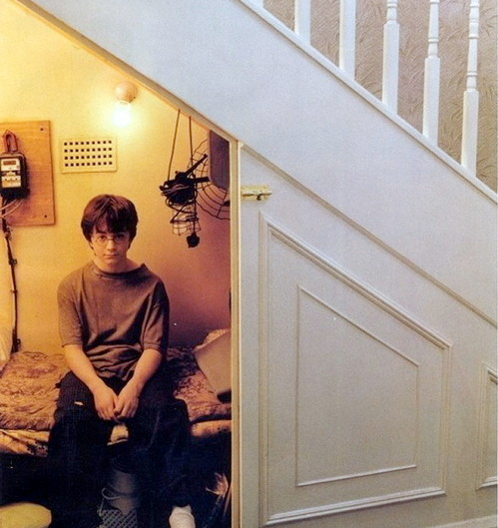
Zone of Comfort

Slide 3
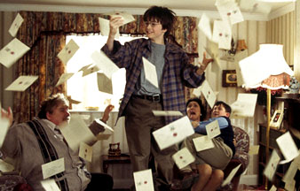
Want/Desire

Slide 4
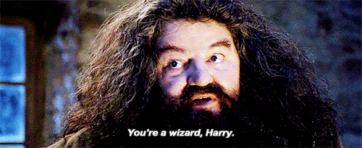
Unfamiliar Situation
Usually with the aid of a mentor

Slide 5
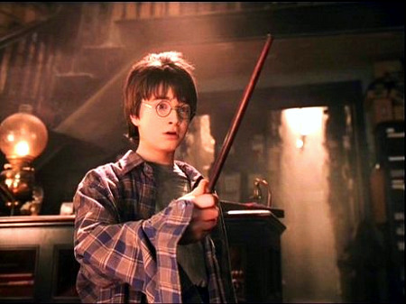
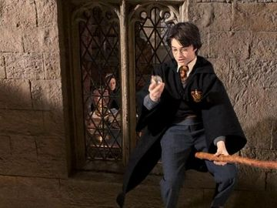
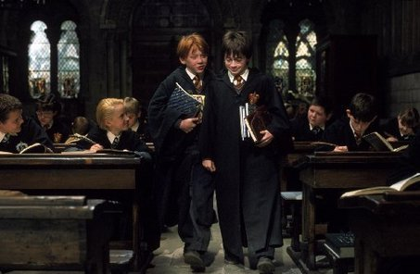
Adaption

Slide 6
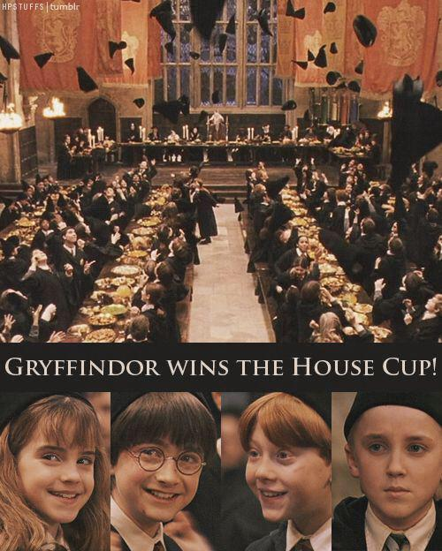
Receive Desire

Slide 7
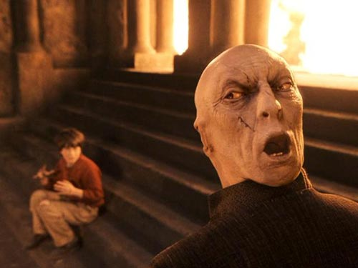
Pay Price

Slide 8
Return to Familiar

Slide 9
Having Changed

Slide 10
Why does it all seem the same?
Stories often use similar aspects in their telling, parts that we are familiar with, to keep the plot moving.
These are called archetypes, a recurrent symbol in literature that often means the same thing
How to Read Literature like a Professor

Slide 11
Damsel in Distress

Slide 12
Old Wise Mentor/Teacher

Slide 13
The “Chosen One”

