Slide 1
An introduction to things fall apart

Slide 2
Things Fall Apart
The book tells the story of the respected man Okonkwo who came from a not so respected family
The traits that are respected are not unlike those we have in American society
Wealth: Yams
Success: Multiple Wives
Hard working
Strong, physically and mentally
However, his worth is tested when he is entered into a “new setting”: his village when it is introduced to Western missionaries.
The story is considered a classic tragic drama.

Slide 3
Tragedy
Reduced Climax=New
problem/New setting
External Problem
Resolution
Great hero with traits that encompass culture’s values
Internal/Fatal Flaw
Dynamic: Changes, he/she is redeemed.
Static: Doesn’t change, dies or has downfall
Lust
Pride
Alcoholic
Tragic Hero

Slide 4
Dramas
Story follows in the vein of Homer in both the idea of tragic and dramas
Includes elements that are usually put in them
Three warnings: Usually from those around them and not from God
Hero’s belief in self: Thinks fate and own strengths will protect them
Gods are represented: In one way or another, “fate” is determined by them
Usually, gods giving the warnings to the hero in form of other
Usually, hero does not recognize the warnings
Became the standard of Western writing in these two genres
Why Achebe wrote it the way he did—showed command of English language and Western archetypes
Considered to be one of the first African novels accepted into the “cannon”

Slide 5
Do It Yourself
Go onto my Weebly. With your pod, answer the Google Form to find each aspect of a tragedy in Shakespeare’s Macbeth.

Slide 6
Pod Discussion
Each pod will be discussing the next few pictures to try and understand the Scramble for Africa
There is no information but the picture itself—it is up to your pod to understand the history of where it went
One student will be the leader for each slide and begin the discussion. While the first speaker is talking, the rest of the pod will make one of three hand gestures in order to show how they feel in response
Thumbs up: I agree and have something to add
Thumbs down: I disagree and have a reason why
Pinky and thumb: I need clarification or have a question.
When the first speaker is finished, they will allow the other members of the pod to speak based on the hand gesture they put up.

Slide 7
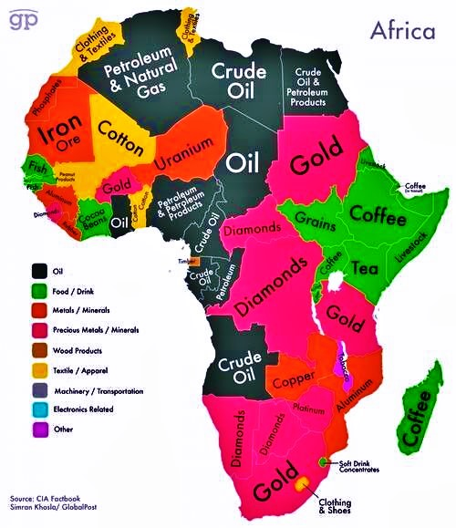

Slide 8
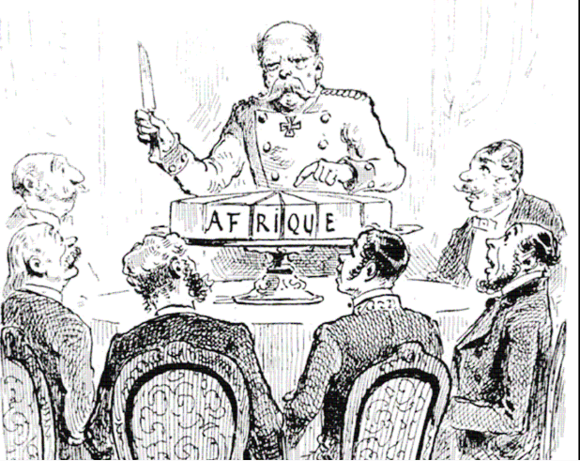

Slide 9
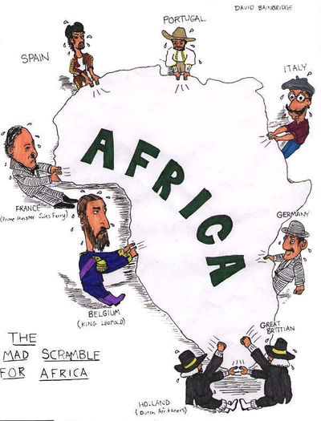

Slide 10
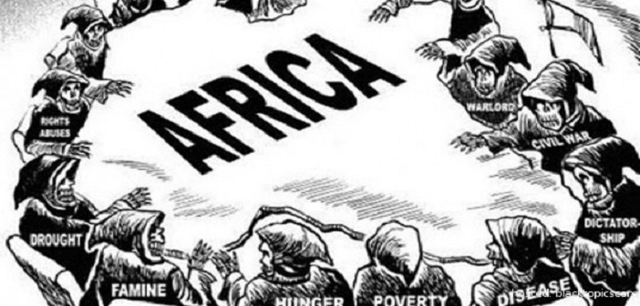

Slide 11
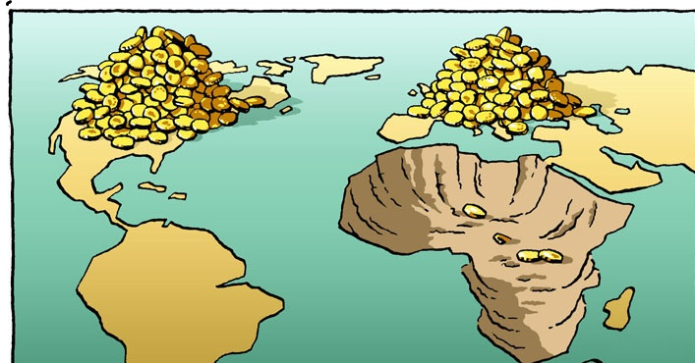

Slide 12
What Did We Come Up With?

