Slide 1
Why do we act as we act?

Slide 2
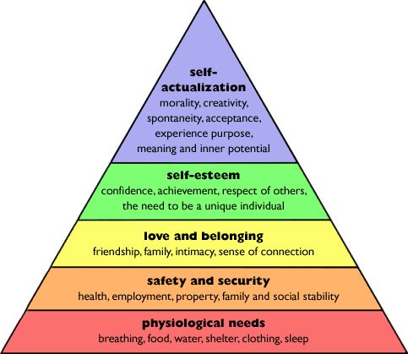
Maslow’s Hierarchy of Needs

Slide 3
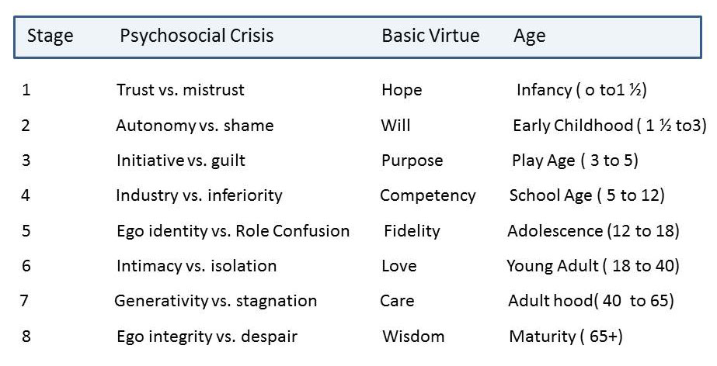
Erikson’s Pyschosocial Stages

Slide 4
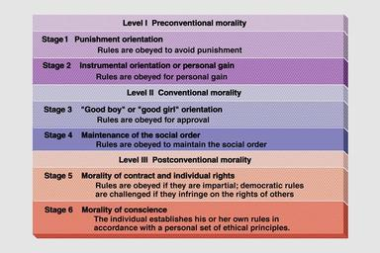
Kohlberg’s Theory of Moral Development

